Slide 1


Slide 2

#LifeKoKaroLift
SGC Coaching:
Articulate your Journey | Activate Students’ Vigour| Accelerate Mutual Growth
Session 2
Data Analysis and Visualization

Slide 3
Agenda: Session 1
Quick Recap –(20 mins)
Last 2 weeks: Learning challenges & complexity
Focused Teaching–(50 mins)
Learn Python Programming through Examples
Doubt resolution –(20 mins)
Discuss Individual problems in exercise

Slide 4



Recap: What the learner have learnt in the week Self-Assessment by Students on their learning curve
Python Programming
Python Packages
Data prep operations
Data Analysis
Pandas
Numpy
Matplotlib
Seaborn
Data Cleaning
Data Manipulation
Subsetting
Functions/loops
Visualization Analysis
Grouping
Tabular Analysis
Notes:
Ask the learners’ confidence level particularly in Non-Technical / Non-Experienced groups

Slide 5
Quiz Time!
In Pandas, When do you use Dataframe vs. Series?
In a file ‘Salaries’, I need to create 3 segments ‘Top’, “Mid’, and ‘High’ to differentiate salary brackets. How can I do that using Pandas?
Which plot is most suitable to compare annual returns for last 3 years by Business lines 1 and 2?
I have 2 arrays of shapes [5,5] and [5,2] respectively. How can I combine them? What will be the shape of output array?
I want to compare standard deviation of 2 samples. How can I do that in 1 step using Python?
Notes:
You can choose other examples but they must be simple enough for a beginner. The interaction matters more in this case.
You can share sample to illustrate if it is not helpful.

Slide 6
Focussed teaching: Practice with open source data
Different groups might need diff content
Python libraries for data wrangling (Numpy, Pandas)
Using visualization to share analysis
Using dataset for illustrations and practice exercise

Slide 7
Focussed teaching: Data Analysis
Data Analysis can be divided into three category
Univariate data : It contain only one variable
Bivariate data: It contain Two variable
Multivariate data: It contain Three or More variables
Notes:
You can choose other examples but they must be simple enough for a beginner. The interaction matters more in this case.
You can share sample to illustrate if it is not helpful.

Slide 8
Focussed teaching: Data Visualization
Data visualization is the graphical representation of information and data. By using visual elements like charts, graphs, and maps, data visualization tools provide an accessible way to see and understand trends, outliers, and patterns in data.
Advantages:
Identify Trends and Outliers
Storytelling
Collect the useful information
Notes:
You can choose other examples but they must be simple enough for a beginner. The interaction matters more in this case.
You can share sample to illustrate if it is not helpful.

Slide 9
Focussed teaching: Data Visualization
Types of Data Visualization:
Temporal: Linear, and that they are one-dimensional
Hierarchical: Order groups within larger groups
Network: Datasets connect deeply with other datasets
Multidimensional: There are always 2 or more variables in the mix to create a 3D data visualization
Geospatial: Real life physical locations, overlaying familiar maps with different data points
Notes:
You can choose other examples but they must be simple enough for a beginner. The interaction matters more in this case.
You can share sample to illustrate if it is not helpful.

Slide 10
Focussed teaching: Data Visualization
Best Practice
Speak to a specific audience
Choose the right visual
Provide context
Keep things simple and digestible
Design for user engagement
Notes:
You can choose other examples but they must be simple enough for a beginner. The interaction matters more in this case.
You can share sample to illustrate if it is not helpful.

Slide 11

Python for Data Preparation
Components of Analysis (Using Pandas/ Numpy)
Data Wrangling in Pandas Using Univariate Data
Data creation/modification: Create Data table
Data Cleaning: Treating null, duplicates, outliers
Slicing: Extracting, Filtering, Subsetting
Mutation: New column assignment, changing structure (pivot, unpivot)
Merging files (outer join, inner join, full outer join)
Table Operations: Sorting, Group by, Aggregations
Function and Loops: How and where to use?
Notes:
For those who have coding background in other languages, it is really helpful. Show with examples on Jupyter notebook using this and next slide.

Slide 12
Focussed teaching: Let’s Code Together
Coding Time

Slide 13
Coding: Things to remember
Stringent Documentation
Scalability
Security
Context
Expected output using comments
Calling out exceptions
Preventing errors
Avoiding infinite loops
Preventing codes to crash (try-except)
Sources of issues
How can you reuse it?
How can you use it for larger data?
Multiple applications using similar codes

Slide 14
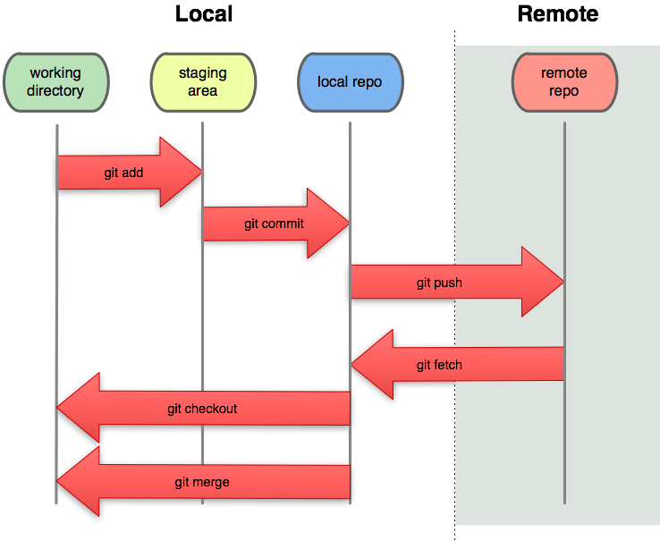
Focussed teaching: Something Extra
Github

Slide 15

Personalized Feedback and Doubt resolution
Doubt Resolution
Questions??

